Slide 1
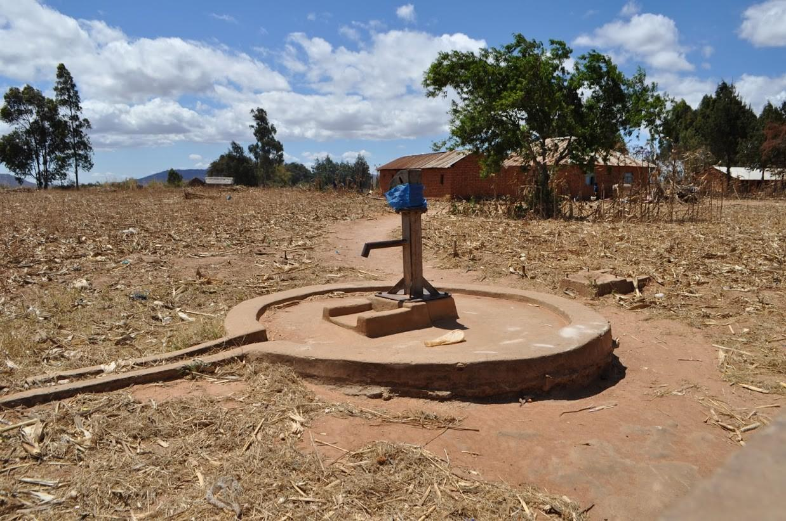
Water Pumps Functionality Prediction in Tanzania!

Slide 2
What is the problem?
Communities either don't have the funds or the knowledge to maintain pumps
They're constantly breaking
Predict which pumps are functional, needs repairs, or don’t work at all
To expedite the process of locating, examining, and fixing the pumps

Slide 3
Why do we care about this problem?
Understand which waterpoints will fail can improve maintenance operations
Ensures that potable water is available to communities across Tanzania
Save many lives in Tanzania
Ensure pumps remain functional
Apply to other countries

Slide 4
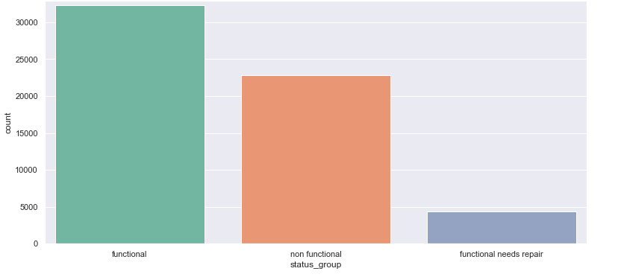
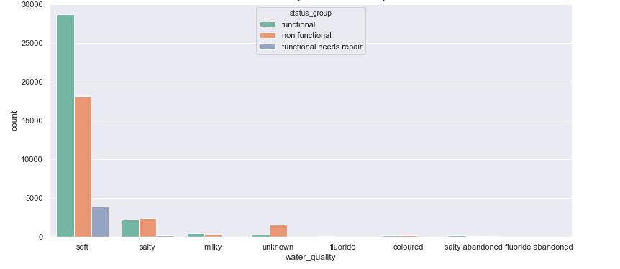
Data Visualization:
Total Count by Pumps Status
Water Pump Status by Water Quality
Notes:
We can see that when the water quality is soft, then there is a very high probability of the water pump being functional. Also, when the water quality is salty, then there is an equal probability of functional and non-functional status!

Slide 5
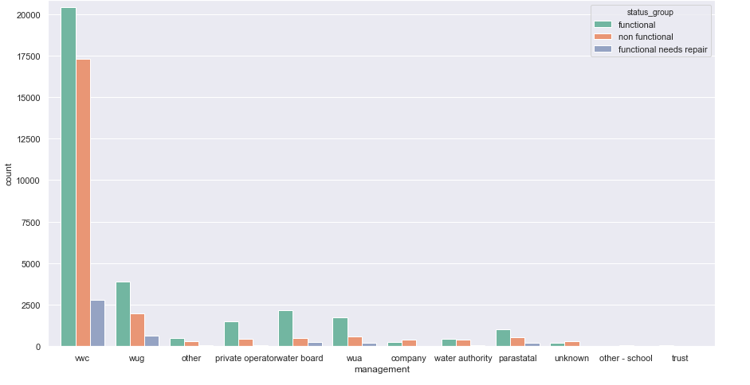
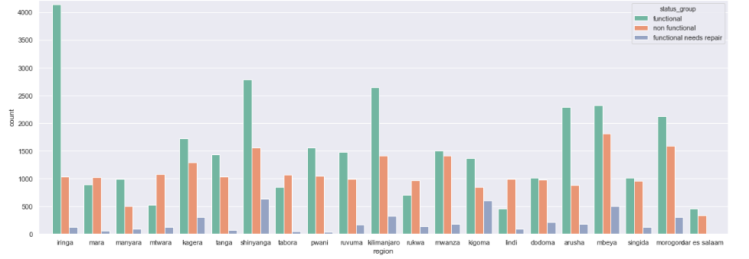
Data Visualization:
Water Pump Status by Management Type
Water Pump Status by Region
Notes:
We can see that in some regions, there is a very high probability of a water pump being functional vs non-functional.
The (vwc) manages approximately 70% of the pumps! They also have the highest numbers of functional and nonfunctional pumps.

Slide 6
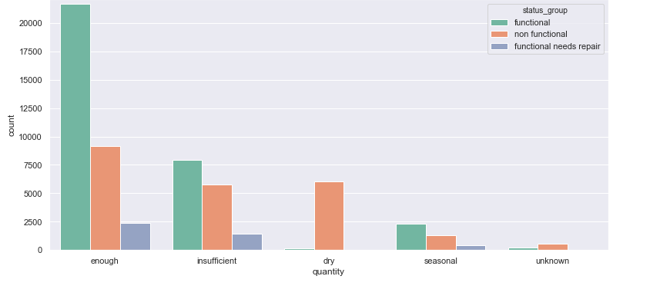
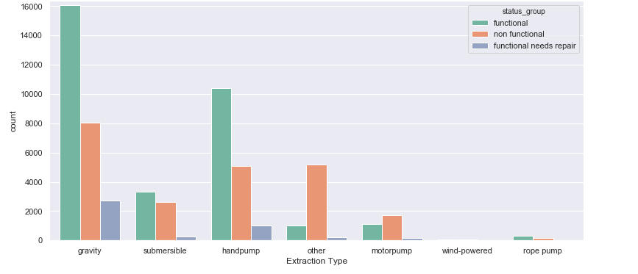
Data Visualization:
Water Pump Status and the Pump Types
Water Quantity in each Water Pump Status
Notes:
70% of the pumps are type gravity and hand pumps. The gravity and hand pump types have the most functional ones. The motor pumps have a higher probability to be nonfunctional than functional.
We can see that if the water pump gets enough water quantity, the probability of it being functional is high. On the other hand, if the water quantity is dry, a water pump is most likely nonfunctional.

Slide 7
Machine Learning:
Multiple lists containing the catg_feature_names, num_feature_names and date_feature_names
Reduction in the levels of categorical data (keeping the top 10 and replacing the rest with ‘OTHER’)
Binarizing the status_group values | functional = 1 - broken,needs repair = 0
Comparing the model scores at the end

Slide 8
ML Models:
Decision Tree:
The accuracy score is 71%
The AUC score is 0.7 which is greater than 0.5. Always a good sign!
Random Forest:
The accuracy score is 82%
The AUC score is 0.898
The ROC Curve and AUC score for Random Forest Classifier is much better

Slide 9
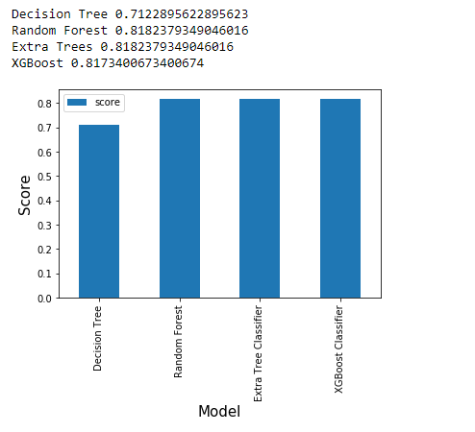
Scores between different models:

Slide 10
Conclusions:
Predict the functional status of a water pump based on water pump attributes and geographical variables
The Ministry of Water can gain reduction in labor costs, saving time by prioritizing servicing of pumps that are most likely to be failing
The overall accuracy of the four models when applied to the test subset ranged from a low of approximately 71% (Decision Tree) to a high of just over 81% (Random Forest)
The Random Forest model is recommended for use by Tanzania’s Ministry of Water

